Slide 1


Master Thesis
Status Update -1
Early Fall Detection in Musltiple Sclerosis Patients Using Deep Neural Networks
By
Tejas Waidande
(11037651)

Slide 2
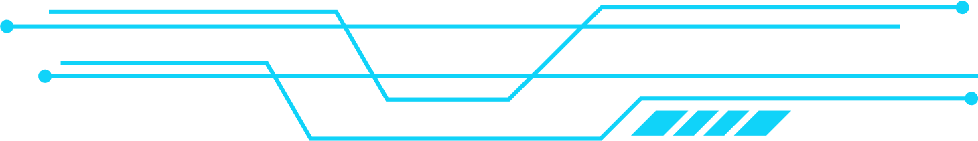

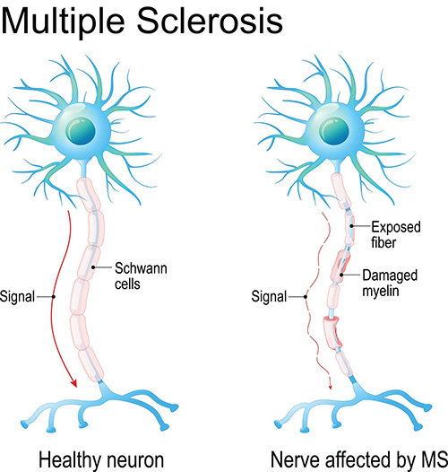

What is Multiple Sclerosis?
A condition that affects nerves in your central nervous system.
That's the brain and spinal cord. In MS, the coating (myelin) that protects your nerves is damaged.
This causes a range of symptoms like blurred vision and problems with how we move, think and feel.
Notes:
-A condition that damages the protective coating (myelin) of nerves.
-leading to symptoms like blurred vision, mobility issues, and cognitive challenges.

Slide 3
Motivation
~50% of pwMS experience at least one fall per year
Traditional models lack accuracy in complex, high-dimensional datasets
Early identification = timely interventions & better outcomes
Supported by regulatory-quality data (MSOAC Placebo)

Slide 4
Problem Statement
This research will show the performance of deep neural network models to classify fallers and non-fallers among pwMS using the MSOAC Placebo Database and many other datasets that consist of clinical, demographic, and functional data. The aim is to show that deep neural networks outperform conventional models in predicting fall risk, supporting future clinical decision-making in terms of early prediction.

Slide 5
Research Objectives
To build a faller vs. non-faller classifier for pwMS using DNN
To evaluate model performance on multiple parameters of MSOAC Placebo data and their impact on the model.
To test the deep learning model until achieveing failure point.
To create a reproducible, patient level fall-risk prediction framework.

Slide 6
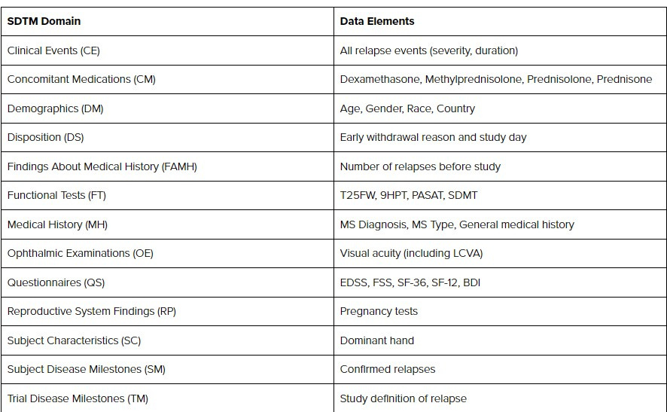
Research Methodology
Dataset: MSOAC Placebo Database (16 clinical trials)
Preprocessing: MongoDB ingestion, column mapping, data cleaning
Modeling: Deep Neural Networks
Evaluation: Accuracy, F1-score, ROC-AUC
Notes:
-A condition that damages the protective coating (myelin) of nerves.
-leading to symptoms like blurred vision, mobility issues, and cognitive challenges.

Slide 7
Current Status
MSOAC Placebo data successfully loaded into MongoDB
Pipeline creation initiated and got a data profiling result for all (21 files analyzed)
identification of performance metrics is ongoig, EDSS,MFIS &NSI have to discovered.
Final problem statement + first research paper documented
Notes:
-A condition that damages the protective coating (myelin) of nerves.
-leading to symptoms like blurred vision, mobility issues, and cognitive challenges.

Slide 8
Current Impediments
Lack of clear column documentation → delays in feature selection
Dataset is not explicitly labeled for fallers → need to engineer outcome labels
Not many researches availble which can define column identification.
Difficulty in merging files with heterogeneous schema
Notes:
-A condition that damages the protective coating (myelin) of nerves.
-leading to symptoms like blurred vision, mobility issues, and cognitive challenges.

